Slide 1

AN AI-POWERED SYSTEM FOR CORRELATING PHYSICAL ACTIVITY AND SUBJECTIVE MENTAL WELL-BEING
Project Work Review-1
Presented by
Harsh Pratap Singh (25MCA1027)
Under the Guidance of
Dr. Saranya G
Assistant professor-Senior Grade
School of Computer Science and Engineering
Vellore Institute of Technology, Chennai.

Slide 2
DOMAIN: DIGITAL HEALTH & AFFECTIVE COMPUTING
Societal Relevance: There is a growing global focus on mental health and
well-being. The WHO reports a significant rise in stress, anxiety, and depressive disorders.
Technological Convergence:
IoT Ubiquity: The explosive growth of wearable sensors (smartwatches, fitness trackers) provides an unprecedented, continuous stream of objective physiological data.
AI Maturity: Advances in Natural Language Processing (NLP) and Machine Learning (ML) now allow us to analyze complex, unstructured human data (like text) at scale.
The Opportunity: This project is at the intersection of these two fields, with the potential to shift healthcare from a reactive treatment model to a proactive, personalized wellness model.

Slide 3
THE PROBLEM: A DISCONNECT BETWEEN MIND AND BODY DATA
Currently, our health data lives separately
Physical Data (Steps, Sleep, Heart Rate) tracked by our phones or smart watch.
Mental Data (Mood, stress, anxiety) often tracked by journaling app.
There is no system that intelligently fuses these two data streams to find personalized connections.
As a result, users receive generic advice (e.g., "Walk 10,000 steps") but miss the personalized insights (e.g., "For you, a 20-minute walk is more impactful on mood than 8 hours of sleep").

Slide 4

LITERATURE REVIEW SUMMARY
S. No | Paper Title | Authors & Year | Objectives | Methodology | Algorithms Used | Features | Merits | Limitations
1 | The relationship between physical activity and mental health: a meta-analysis | Schuch, F. B. et al. (2018) | To quantify the effect of physical activity on depression and anxiety. | Meta-analysis of longitudinal and cross-sectional studies. | Statistical analysis (meta-regression) | Physical activity levels, depression scores (e.g., PHQ-9) | Establishes a strong, quantitative link between exercise and positive mental health outcomes. | Does not explore personalized relationships or real-time data; analysis is at a large population level, not individual (n-of-1).
2 | Wearable sensors for monitoring mental health: A systematic review | He, L. et al. (2020) | To review the use of wearable sensors (activity, HRV, sleep) in detecting and monitoring mental health conditions. | Systematic literature review. | N/A | Steps, Heart Rate Variability (HRV), Sleep, Electrodermal Activity (EDA) | Comprehensive overview of which sensors map to which conditions (e.g., HRV to stress). | Highlights that most studies are observational; very few systems use this data for a real-time, actionable feedback loop for the user.
3 | Sleep, Health, and Wellness: A Review of the National Sleep Foundation's key findings | Czeisler, C. A. (2015) | To summarize the scientific literature on the relationship between sleep duration/quality and health outcomes. | Literature review. | N/A | Sleep duration, sleep quality, health metrics (mood, cognition) | Strongly validates that sleep is a critical and measurable predictor of mood and cognitive performance. | Lacks integration with other lifestyle data (like journaling or daily stress) in a single platform.
4 | Passive sensing of daily routines and social interactions to predict mood in bipolar disorder | Wang, R. et al. (2018) | To use passive smartphone sensor data to predict mood state changes in individuals with bipolar disorder. | Longitudinal study with 40 participants using a custom app (EmotionSense). | Logistic Regression, Random Forest | GPS location, phone usage (screen time), activity (accelerometer) | High accuracy in predicting mood state. Proves passive sensing is a powerful, non-invasive tool. | Relies on a clinical population; does not incorporate subjective user input (like a journal) to explain why a mood change occurred.
5 | Stress and Heart Rate Variability: A Meta-Analysis and Review of the Literature | Kim, H. G. et al. (2018) | To meta-analyze the relationship between psychological stress and HRV. | Meta-analysis and systematic review. | Statistical analysis (Meta-analysis) | HRV (Time and Frequency domain), self-reported stress levels | Quantifies that low HRV is strongly associated with high psychological stress. | Confirms HRV is a valid biomarker but does not propose a system for continuous monitoring and feedback.

Slide 5
6 | The effect of wearables on sleep in healthy individuals: a randomized crossover trial and validation study | de Zambotti, M. et al. (2021) | To study if wearing a sleep-tracking wearable device (Fitbit) improves sleep quality in healthy adults. | Randomized crossover trial. | Linear mixed models | Wearable sleep data (Fitbit), self-reported sleep quality | Found that wearables can improve self-reported sleep quality and modify sleep behaviors. | Focuses on the effect of the wearable itself, not on correlating the wearable's data with other inputs like mood journals.
7 | Passive Sensing for Mental Health Monitoring Using Machine Learning With Wearables and Smartphones: Scoping Review | Zhang, Y. et al. (2023) | To review the current state of passive sensing and ML models for monitoring mental disorders. | Scoping review of 42 studies. | N/A | HR, step count, movement index, sleep, GPS | Provides a recent overview of biomarkers. Shows Deep Learning models are highly accurate. | Most studies focus on clinical disorders (e.g., depression) and are cohort designs, not general wellness tools.
8 | Exploring the relationship between resting heart rate and mood in daily life | Verkuil, B. et al. (2016) | To investigate the link between resting heart rate (RHR) and daily mood. | Ecological Momentary Assessment (EMA) study. | Multilevel models | RHR (wearable), self-reported mood (app) | Found that a higher RHR in the morning is associated with lower positive affect and higher negative affect during the day. | A key correlational finding, but does not build an AI model to predict or provide feedback based on this.
9 | Detection and monitoring of stress using wearables: a systematic review | E-N, L. et al. (2024) | To systematically review wearable-based approaches for stress detection. | Systematic review. | N/A | EDA, HRV, ECG, skin temp. | Confirms that ML models trained on wearable data can detect stress. | Highlights data heterogeneity and small sample sizes as major challenges in the field.
10 | VADER: A Parsimonious Rule-based Model for Sentiment Analysis of Social Media Text | Hutto, C. J., & Gilbert, E. (2014) | To create and validate a sentiment analysis tool (VADER) optimized for informal text. | Model development and validation against other sentiment classifiers. | Rule-based, lexicon-based (VADER) | Sentiment score (valence), intensity | High accuracy on informal text (e.g., journals). Fast, lightweight, and doesn't require training data. | Lacks deep contextual understanding (e.g., sarcasm) that larger models might capture; provides a score, but not deeper themes.
11 | Deep learning for language in health | Wu, S. et al. (2020) | To review how deep learning models (like BERT) are used to extract insights from clinical text and personal health narratives. | Literature review. | BERT, LSTMs, CNNs | Text from clinical notes, social media, journals | Demonstrates that deep learning can move beyond simple sentiment to identify complex themes like "social isolation" or "medication side effects." | These models are computationally heavy and require large datasets. Often lack a direct link to quantifiable sensor data.
12 | Mental health and social media: A computational approach to understanding the user's "voice" | Gkotsis, G. et al. (2017) | To use NLP to analyze the language of users on social media to identify markers of depression. | Data collection from Twitter; comparative analysis of NLP classifiers. | SVM, Naive Bayes, BERT | N-grams, emotional valence, topics | Successfully identifies linguistic markers associated with depression. | Ethical concerns with passive social media monitoring; data is public, not a private, self-reflective journal.

Slide 6
13 | Journaling for mental health: A review of the benefits and the role of technology | Krafft, P. M., & El-Nasr, M. S. (2018) | To review the psychological benefits of journaling and how technology can support it. | Literature review. | N/A | Journaling frequency, content, user engagement | Confirms journaling is clinically effective. Suggests AI can help by prompting users or identifying themes. | Most "smart journals" only offer prompts or basic sentiment. They do not correlate the journal with the user's physical life (activity/sleep).
14 | EMO Diary: Daily Diary with Sentiment Analysis | B, R. S. et al. (2025) | To develop a full-stack web application for daily journaling with built-in sentiment analysis. | System development. | NLP, ML Classification | Text and voice input, sentiment classification (e.g., happy, sad) | A practical implementation of a "smart journal" for personal well-being. | The system analyzes the journal in isolation. It is not fused with any physiological or activity sensor data.
15 | Natural language processing for mental health interventions: a systematic review | L. A. M. et al. (2023) | To review the growth and types of NLP used in mental health interventions (MHI). | Systematic review. | LLMs, Transformers, rule-based | Therapy transcripts, online messages | Shows rapid growth in NLP for MHI since 2019, with a shift to larger models. | Most interventions are therapy-based (e.g., analyzing clinical transcripts), not self-management tools for everyday wellness.
16 | Effectiveness of an AI-based NLP intervention for depression and anxiety | Fulmer, R. et al. (2018) | To test if an AI chatbot (Tess) based on CBT can reduce depression and anxiety symptoms. | Randomized controlled trial (RCT). | Rule-based NLP, CBT principles | Chatbot (Tess) | Showed that an NLP-based intervention significantly reduced symptoms compared to a control group. | This is a chatbot (conversational agent), not a passive analysis tool that correlates journal data with sensor data.
17 | Sentiment Analysis for Mental Health: Challenges and Opportunities | Isreal, O. et al. (2025) | To explore the challenges and opportunities of applying sentiment analysis to mental health. | Literature review / Position paper. | N/A | NLP, sentiment, context | Discusses key challenges: detecting subtle emotions, understanding context, and cultural differences. | simple sentiment analysis is not enough; it must be combined with other data (like wearables) for a full picture.
18 | A Multi-Modal Approach to Depression Detection using Speech, Activity, and Text | Alghowinem, S. et al. (2018) | To fuse data from speech, text, and activity sensors to improve depression detection. | Data collection from 100 participants; fusion of multiple data streams. | Random Forest, SVM, Deep Learning | Vocal features, sentiment scores, step count | Fusion of all three modes achieved significantly higher accuracy (over 85%) than any single data mode alone. | Focus is on clinical diagnosis (depression) for a doctor, not on proactive wellness insights for a general user.
19 | Cross-modal Correlation Learning for Multi-modal Health Data | Du, Y. et al. (2019) | To propose a model that can find correlations between different data types (e.g., images and text) in health records. | Model development on public datasets (MIMIC-III). | Deep Cross-Modal Hashing | Medical images, clinical notes | Presents a sophisticated AI technique for finding complex, non-linear correlations between different data types. | Highly theoretical; complex to implement; not applied to real-time personal wellness data (activity + journal).

Slide 7
20 | Digital Phenotyping for Mental Health: A review | Torous, J. et al. (2017) | To define "Digital Phenotyping" and review its application in mental health. | Systematic review. | N/A | Smartphone sensors, GPS, call logs, text, wearables | Establishes the entire field of using personal device data to create a "phenotype" of a user's mental state. | Most systems collect data, but few return meaningful, personalized, and actionable insights to the user.
21 | StudentLife: Assessing Mental Health, Academic Performance and Behavioral Trends of College Students using Smartphones | Wang, R. et al. (2014) | To passively track a cohort of students using smartphones to find correlations between sensor data and academic/mental health outcomes. | Longitudinal study with 48 students. | Correlation analysis, Decision Trees | Activity, sleep, social interaction (audio), location (GPS) | Successfully correlated sensor data with GPA and depression scores. A landmark paper in passive sensing. | The insights were for the researchers, not the students. The system did not provide a personalized feedback loop.
22 | Multimodal Machine Learning in Mental Health: A Survey of Data, Algorithms, and Challenges | C. J. et al. (2024) | To survey the landscape of multi-modal ML in mental health, including datasets and fusion strategies. | Survey paper. | Transformers, GNNs, Hybrid Fusion | Audio, visual, physiological, text modalities | Catalogs public datasets and fusion strategies. Confirms MML yields higher accuracy than any single channel alone. | Highlights fragmented data, privacy, and lack of longitudinal, "in-the-wild" benchmarks as major open challenges.
23 | Fusing Wearable Biosensors with Artificial Intelligence for Mental Health Monitoring: A Systematic Review | L. H. et al. (2025) | To review AI models using wearable biosensor data to predict mental health conditions. | Systematic review of 48 studies. | AI, ML models | HRV, EDA/GSR, ACC, PPG | Observes a strong upward trend in AI-driven biosensing for mental health. | Notes that lack of ecological validity, small sample sizes, and data heterogeneity are key methodological challenges.
24 | Harnessing Digital Phenotyping for Early Self-Detection of Psychological Distress | B. N. et al. (2025) | To explore how digital phenotyping can be used for self-detection of emotional distress. | System design and mixed-method evaluation. | Digital Phenotyping | Active (mood entries) and Passive (smartphone sensors) data | Proposes a prototype system (ESFY) for self-detection. | Focus is on detection of distress, not on correlating specific lifestyle factors (like sleep/steps) with mood to provide actionable suggestions.
25 | A review of physiological and behavioral monitoring with digital sensors for neuropsychiatric illnesses | S. K. et al. (2018) | To review how digital sensors can monitor neuropsychiatric illness. | Review paper. | ML algorithms | Actigraphy, location, word sentiment, voice tone, HR | Explicitly mentions fusing multiple data types (e.g., sentiment + HR). | Reinforces that data is high-dimensional and requires new methods, but focuses on clinical illness, not general wellness.
26 | Multimodal Data Fusion for Depression Detection Approach | S. B. et al. (2024) | To propose and compare early and late fusion networks for depression detection using audio and text. | Model development and comparison. | CNNs, TF-IDF, Early & Late Fusion | Audio (MFCCs), Text (TF-IDF) | Demonstrates that fusing audio and text is highly effective, with early fusion performing best. | This is audio + text, not sensor data (activity/sleep) + text. The core idea of fusion is similar, but the data types are different.

Slide 8
27 | A Comprehensive Survey on Wearable Computing for Mental and Physical Health Monitoring | B. T. et al. (2024) | To provide a survey on wearable computing for health, including AI/ML algorithms. | Survey paper. | AI, ML, Embedded AI | Physiological and behavioral parameters | Positions wearable computing as a cornerstone of preventive and personalized healthcare. | Survey is broad; does not detail a specific system for fusing wearable data with journal text.
28 | Understanding User Perceptions of Personalized Feedback in Digital Health Tools | C. A. G. et al. (2025) | To explore how users perceive and respond to personalized feedback from digital health tools. | Qualitative study (semi-structured interviews). | Thematic Analysis | Personalized feedback, user engagement | Finds that users value adaptive, empathetic, and contextually relevant feedback. Trust is a key factor. | This paper explains how the feedback should be, but doesn't build the AI system that generates it. This justifies your "Insight Generation Layer."
29 | n-of-1-path: a path-analysis approach for finding personalized (n-of-1) health effects from time-series data | M. C. et al. (2019) | To propose a novel statistical method for finding personalized (n-of-1) causal relationships from individual time-series data. | Methodological development. | Path Analysis, Statistical modeling | Time-series data (e.g., sensor data) | Proposes a specific, advanced method for finding personalized effects, which is exactly what your project aims to do. | Highly statistical and complex. A full implementation may be beyond the scope of one project, but it proves the need for "n-of-1" models.
30 | MyBehavior: A System for Long-Term Personalized Health Coaching | Rabbi, M. et al. (2015) | To develop a mobile system that models the relationships between an individual's behavior (activity, sleep) and their self-reported well-being to provide personalized feedback. | Deployed a mobile app that passively tracks sensor data and uses Ecological Momentary Assessment (EMA) for self-reports. | N-of-1 statistical modeling (Vector Autoregression - VAR), Correlation analysis. | Passive sensing (activity, sleep, location), EMA prompts for mood/stress, personalized correlation models. | A pioneering system in personalized, n-of-1 health coaching. It's one of the first to build a personalized model for each user instead of a general one. | The self-reports are structured (e.g., "Mood: 1-5"), not unstructured journals. It does not use NLP to analyze the context or themes of a user's day, which is a key part of your project's novelty.

Slide 9
RESEARCH GAPS
The Personalization Gap (n-of-1):
Most studies stop at general correlations (e.g., "sleep affects mood in a 1000-person study").
Gap: There is a distinct lack of systems designed to find personalized, individual-specific (n-of-1) correlations and present them to the user.
The Integration Gap (Siloed Systems):
Activity trackers track activity. Journaling apps are for journals.
Gap: Few, if any, commercially available systems natively integrate and deeply analyze these two data streams within a single, unified platform.
The Actionability Gap (The "Feedback Loop"):
Even when insights are found, they are often just published in a paper.
Gap: There is no "closed-loop" system that translates these complex statistical findings back into simple, actionable, and timely suggestions for the end-user.

Slide 10
RESEARCH OBJECTIVES
To design and develop a unified mobile application that securely integrates subjective journal data (text) with objective physiological data (from the Health Connect API).
To implement and validate an NLP-based sentiment analysis model to accurately quantify the emotional valence (e.g., a "mood score") from the user's unstructured journal entries
To apply a machine learning correlation model (e.g., Random Forest) to the fused dataset to identify and rank the personalized impact of key physical metrics (e.g., sleep, steps, HRV) on the user's quantified mood.
To create and evaluate a novel feedback system that presents these personalized insights back to the user in a simple, understandable, and actionable format.

Slide 11
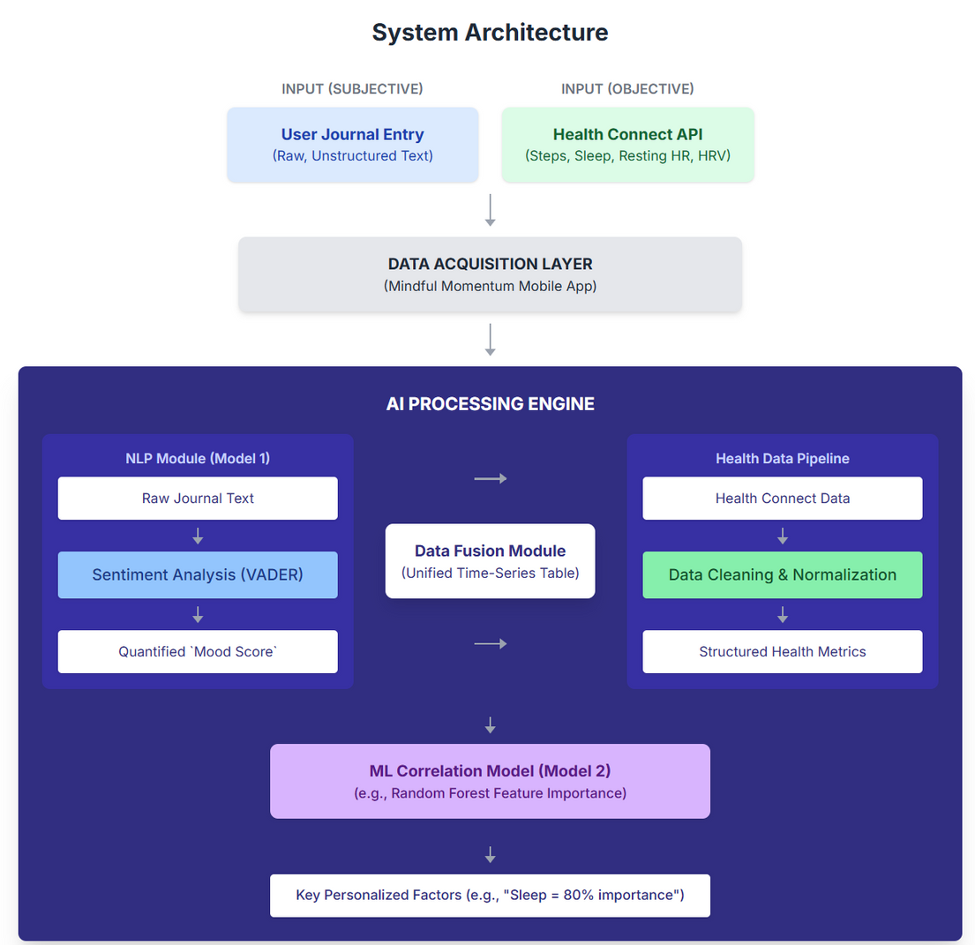
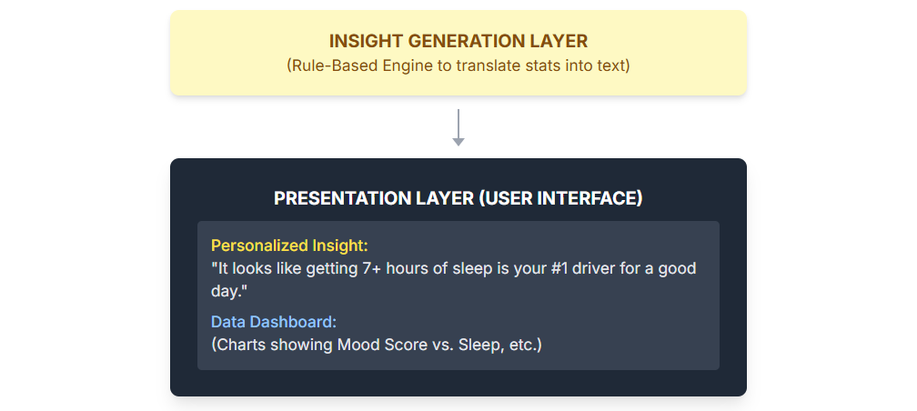
PROPOSED APPROACH & SYSTEM ARCHITECTURE

Slide 12
SIGNIFICANCE OF THE SOLUTION
To design and develop a unified mobile application that securely integrates subjective journal data (text) with objective physiological data (from the Health Connect API).
To implement and validate an NLP-based sentiment analysis model to accurately quantify the emotional valence (e.g., a "mood score") from the user's unstructured journal entries.
To apply a machine learning correlation model (e.g., Random Forest) to the fused dataset to identify and rank the personalized impact of key physical metrics (e.g., sleep, steps, HRV) on the user's quantified mood.
To create and evaluate a novel feedback system that presents these personalized insights back to the user in a simple, understandable, and actionable format.

Slide 13
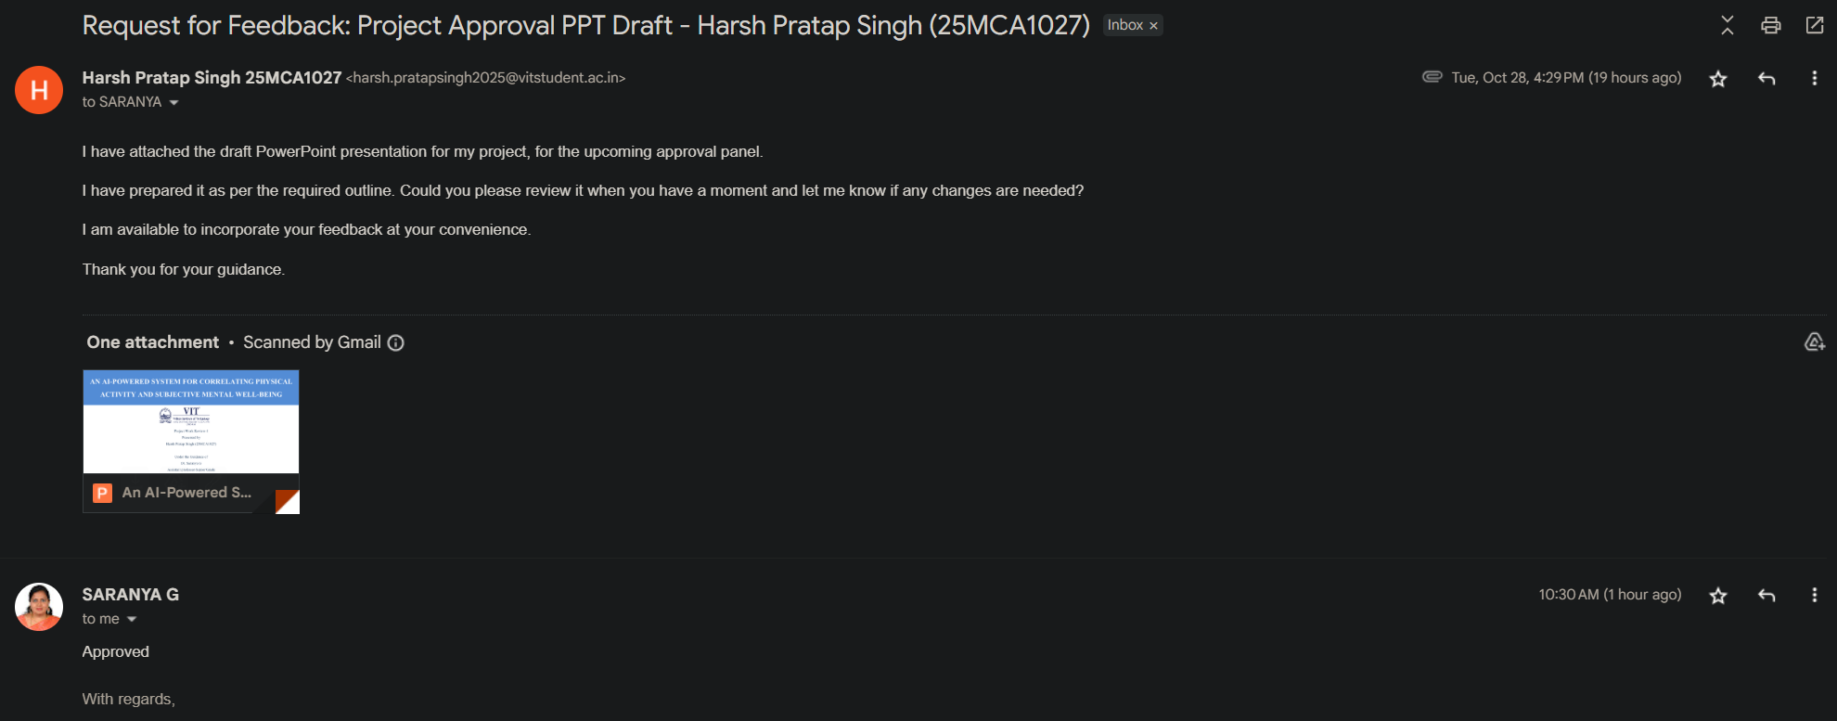
GUIDE'S APPROVAL

Slide 14
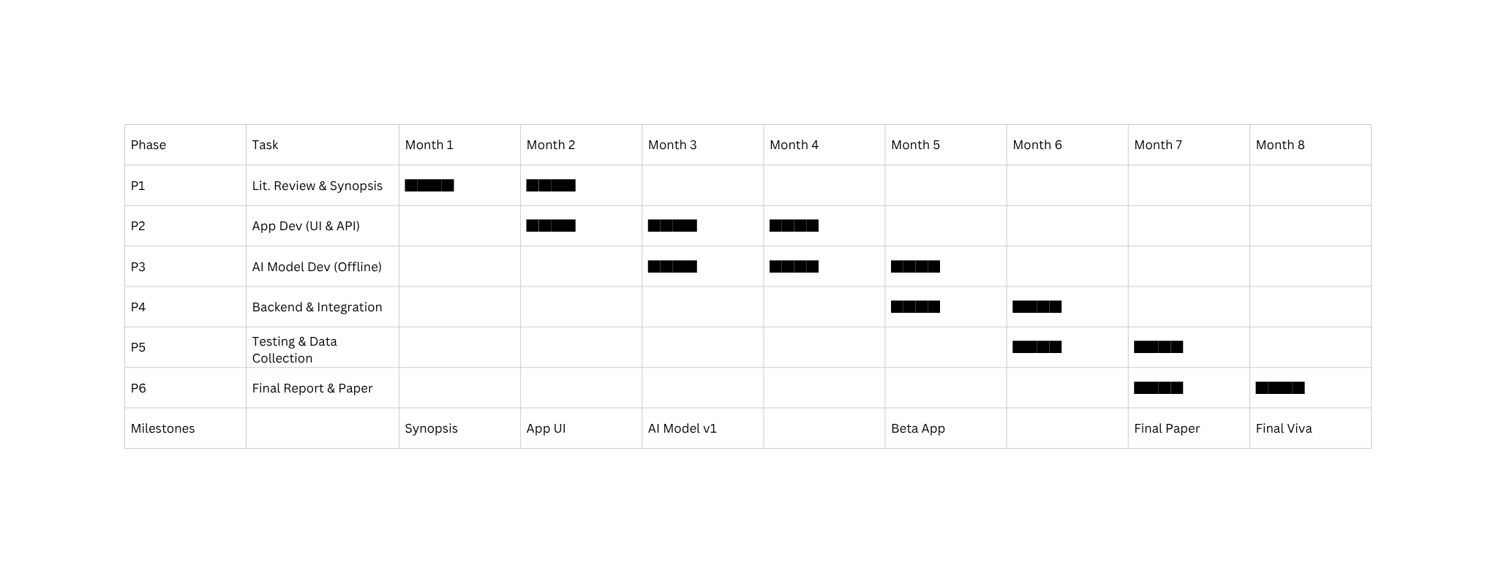
PROJECT PLAN & TIMELINE

Slide 15
REFERENCES
Schuch, F. B. et al. (2018). "The relationship between physical activity and mental health: a meta-analysis." Journal of Psychiatric Research.
He, L. et al. (2020). "Wearable sensors for monitoring mental health: A systematic review." IEEE Transactions on Biomedical Engineering.
Czeisler, C. A. (2015). "Sleep, Health, and Wellness: A Review of the National Sleep Foundation's key findings." Sleep Health.
Wang, R. et al. (2018). "Passive sensing of daily routines and social interactions to predict mood in bipolar disorder." Proc. ACM on Interactive, Mobile, Wearable and Ubiquitous Technologies (IMWUT).
Kim, H. G. et al. (2018). "Stress and Heart Rate Variability: A Meta-Analysis and Review of the Literature." Psychiatry Investigation.
de Zambotti, M. et al. (2021). "The effect of wearables on sleep in healthy individuals: a randomized crossover trial and validation study." JMIR Mhealth Uhealth.
Zhang, Y. et al. (2023). "Passive Sensing for Mental Health Monitoring Using Machine Learning With Wearables and Smartphones: Scoping Review." JMIR Mhealth Uhealth.
Verkuil, B. et al. (2016). "Exploring the relationship between resting heart rate and mood in daily life." Motivation and Emotion.
E-N, L. et al. (2024). "Detection and monitoring of stress using wearables: a systematic review." Frontiers in Computer Science.
Hutto, C. J., & Gilbert, E. (2014). "VADER: A Parsimonious Rule-based Model for Sentiment Analysis of Social Media Text." Proc. Eighth Int. AAAI Conf. on Weblogs and Social Media (ICWSM '14).

Slide 16
REFERENCES
Wu, S. et al. (2020). "Deep learning for language in health." Nature Medicine.
Gkotsis, G. et al. (2017). "Mental health and social media: A computational approach to understanding the user's 'voice'." JMIR Mental Health.
Krafft, P. M., & El-Nasr, M. S. (2018). "Journaling for mental health: A review of the benefits and the role of technology." ResearchGate.
B, R. S. et al. (2025). "EMO Diary: Daily Diary with Sentiment Analysis." International Journal of Scientific Research and Engineering Trends (IJSRET).
Leitner, A. M. et al. (2023). "Natural language processing for mental health interventions: a systematic review." JMIR Mental Health.
Fulmer, R. et al. (2018). "Effectiveness of an AI-based NLP intervention for depression and anxiety." JMIR Mhealth Uhealth.
Isreal, O. et al. (2025). "Sentiment Analysis for Mental Health: Challenges and Opportunities." ResearchGate.
Alghowinem, S. et al. (2018). "A Multi-Modal Approach to Depression Detection using Speech, Activity, and Text." Proc. Int. Conf. on Multimodal Interaction (ICMI '18).
Du, Y. et al. (2019). "Cross-modal Correlation Learning for Multi-modal Health Data." ResearchGate.
Torous, J. et al. (2017). "Digital Phenotyping for Mental Health: A review." JMIR Mhealth Uhealth.

Slide 17
REFERENCES
Wang, R. et al. (2014). "StudentLife: Assessing Mental Health, Academic Performance and Behavioral Trends of College Students using Smartphones." Proc. ACM Int. Joint Conf. on Pervasive and Ubiquitous Computing (UbiComp '14).
C. J. et al. (2024). "Multimodal Machine Learning in Mental Health: A Survey of Data, Algorithms, and Challenges." arXiv preprint arXiv:2407.16804.
L. H. et al. (2025). "Fusing Wearable Biosensors with Artificial Intelligence for Mental Health Monitoring: A Systematic Review." ResearchGate.
B. N. et al. (2025). "Harnessing Digital Phenotyping for Early Self-Detection of Psychological Distress." ResearchGate.
S. K. et al. (2018). "A review of physiological and behavioral monitoring with digital sensors for neuropsychiatric illnesses." PubMed Central (PMC).
S. B. et al. (2024). "Multimodal Data Fusion for Depression Detection Approach." MDPI Algorithms.
B. T. et al. (2024). "A Comprehensive Survey on Wearable Computing for Mental and Physical Health Monitoring." MDPI Sensors.
C. A. G. et al. (2025). "Understanding User Perceptions of Personalized Feedback in Digital Health Tools." ResearchGate.
M. C. et al. (2019). "n-of-1-path: a path-analysis approach for finding personalized (n-of-1) health effects from time-series data." JMIR Mhealth Uhealth.
Rabbi, M. et al. (2015). "MyBehavior: A System for Long-Term Personalized Health Coaching." Proc. ACM Int. Joint Conf. on Pervasive and Ubiquitous Computing (UbiComp '15).

Slide 18
THANK YOU

